Slide 1
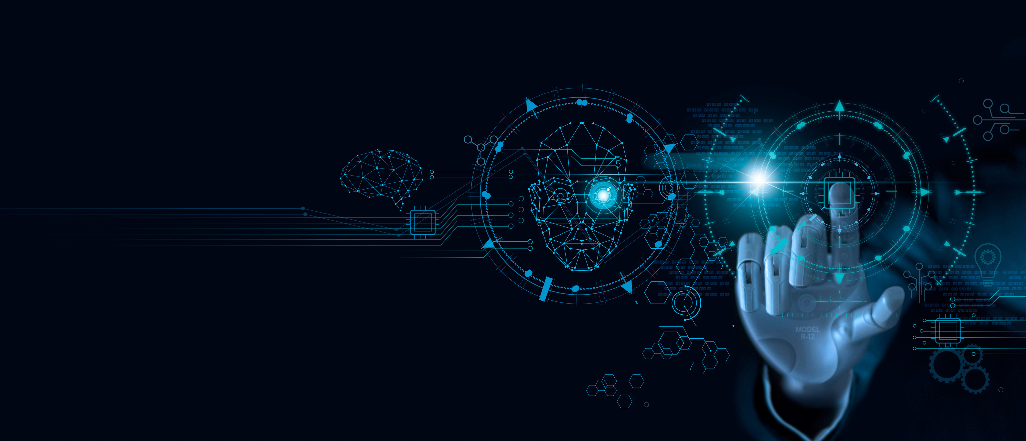


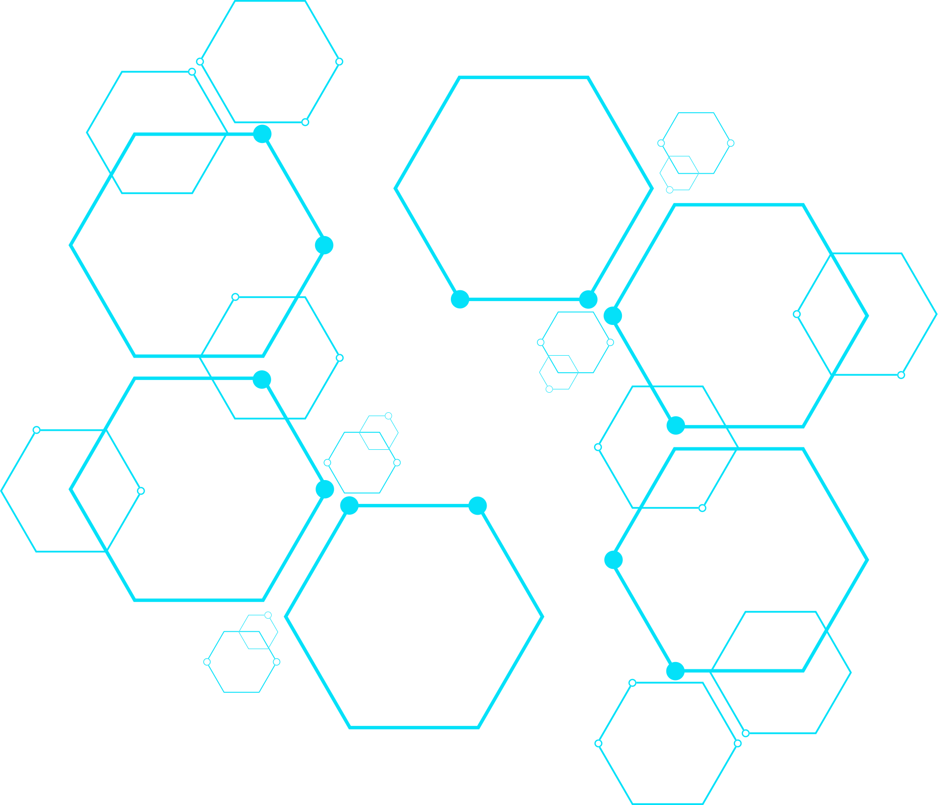
Infyra
AI POWERED MATH TUTOR
USING HAND GUESTURES
Presented By
Team Infyra

Slide 2

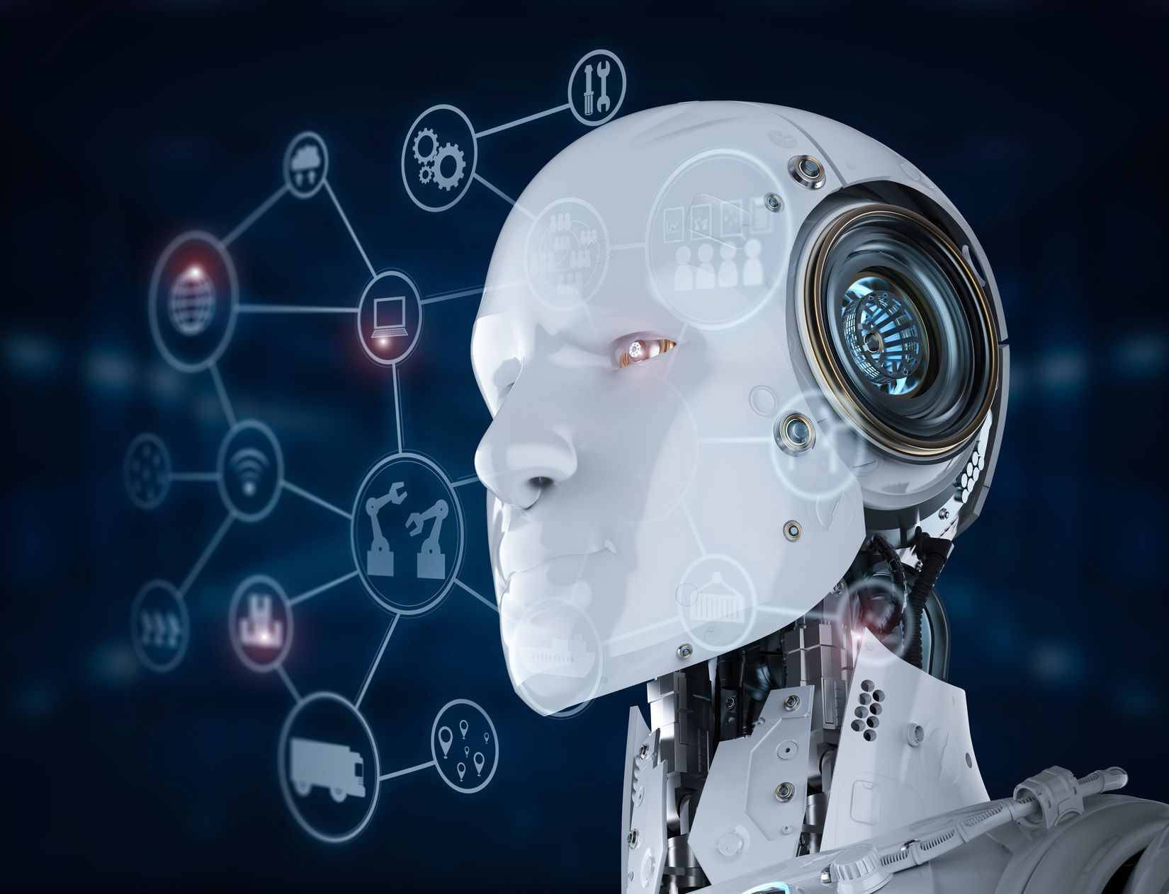
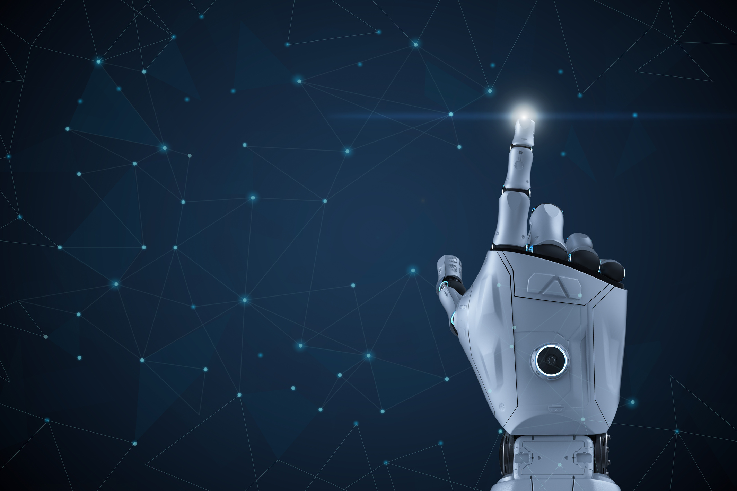
Infyra
Introducing
Our TEAM
Team Infyra is a group of five passionate minds united by a love for technology and innovation:
Allen Kuriyan
Alaina S S
Anncee E L
Arjun C (Team Leader)
Gowri V Gopal
As part of the Advanced AI Training Program, we were inspired to build an AI-powered solution that simplifies learning. That vision gave rise to our project:
XplainIt — An AI Math Tutor.

Slide 3
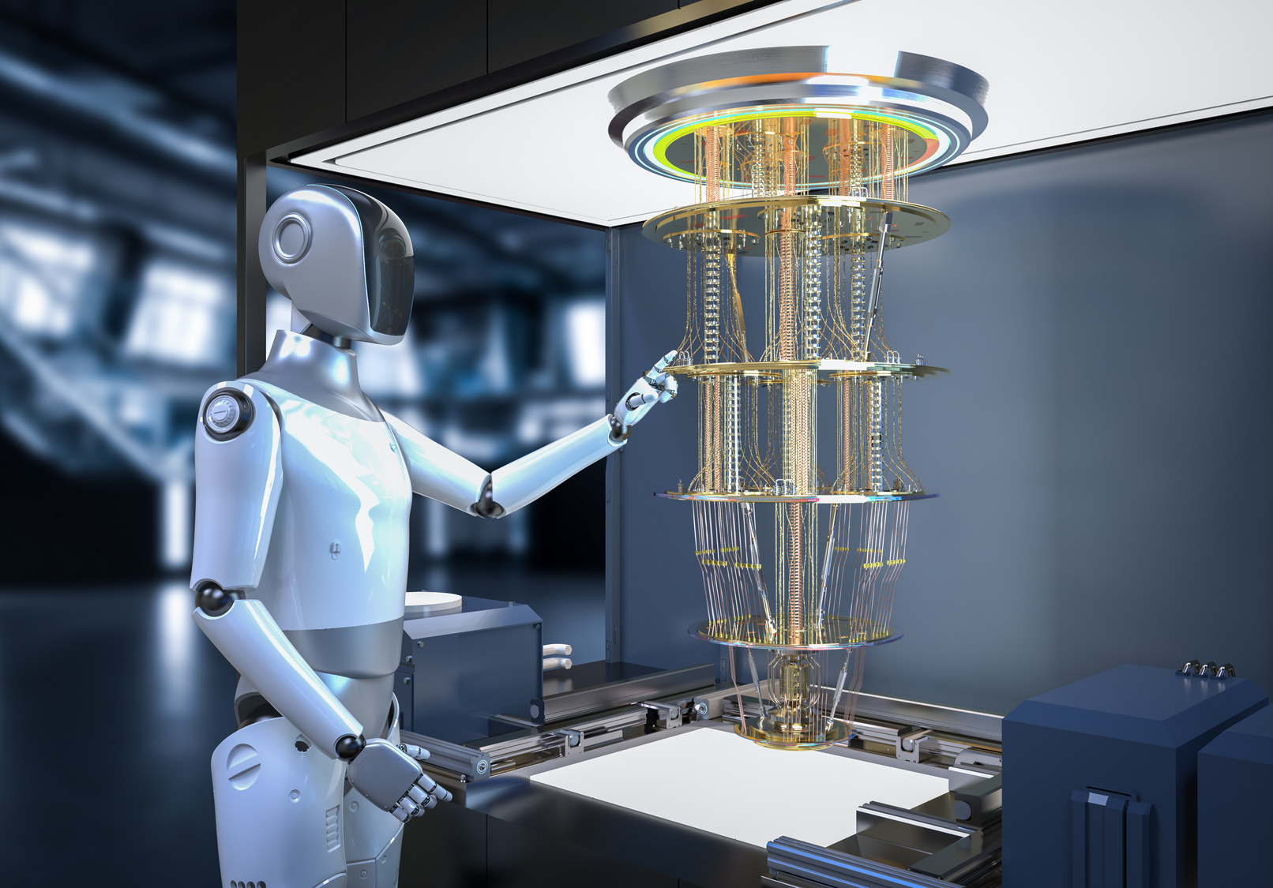

Infyra
Think it, Draw it
XPLAINIT
XplainIt is an AI-powered math tutor designed to help students grasp complex mathematical concepts through clear, step-by-step explanations. Built for accessibility and ease, it adapts to learners' needs using natural language and intelligent feedback.
Smarter Math Learning
Real-World Use Cases
Responsible AI Practices

Slide 4

Infyra
What is
XplainIt
XplainIt is a virtual math tutor that takes hand gestures as input.
You draw numbers or symbols with your fingers.
It detects the gesture, understands the math problem, and provides the answer in both text and voice.
Example: "Imagine showing '2 + 3' using your fingers—and hearing ‘The answer is 5’. That’s XplainIt."

Slide 5
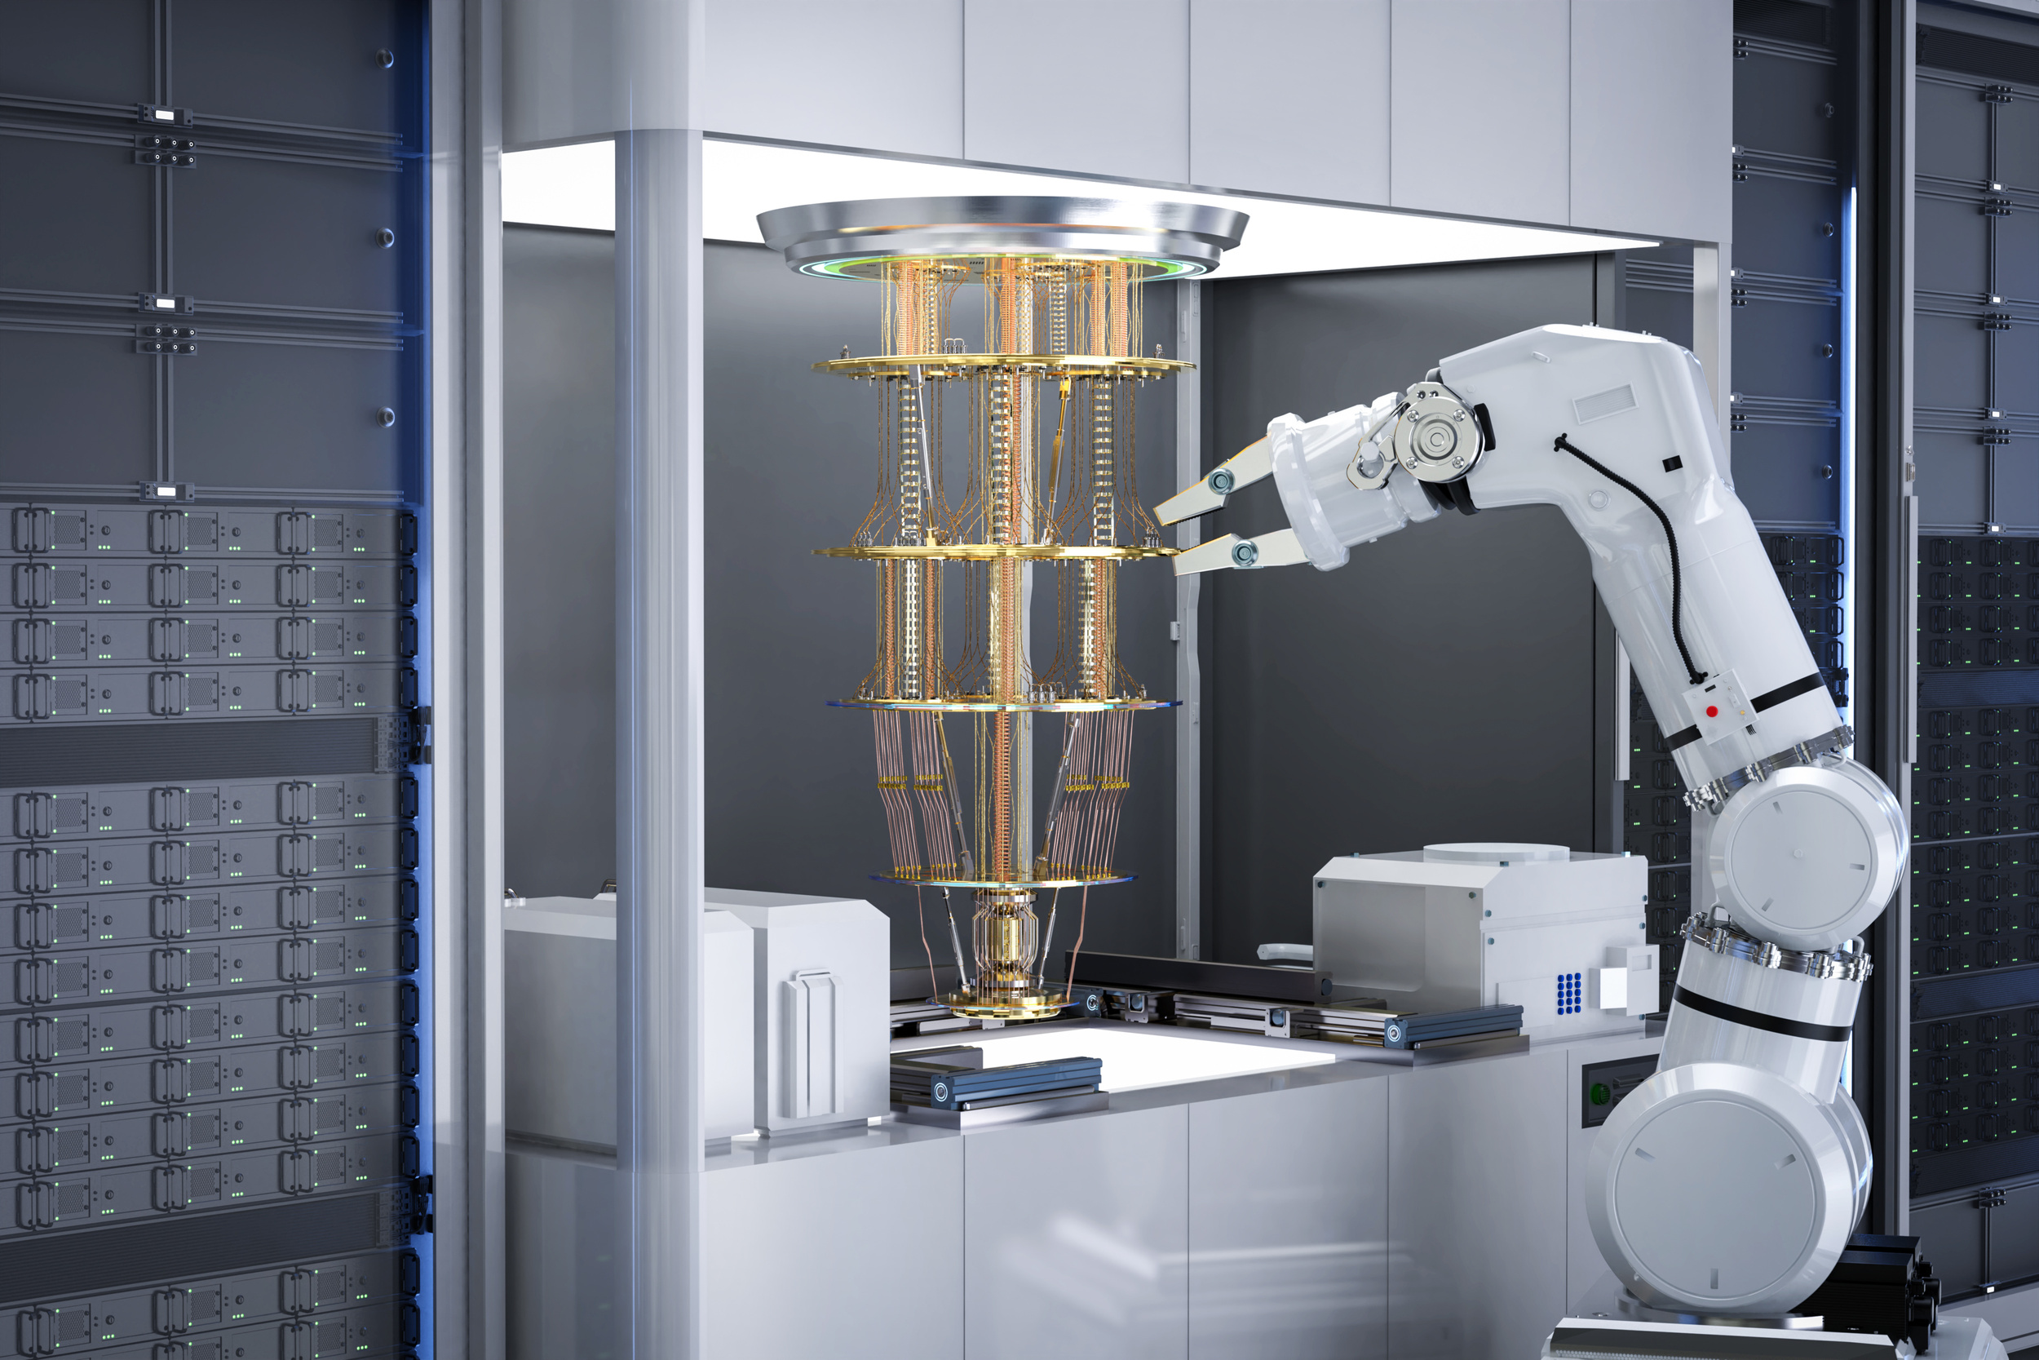

Infyra
XplainIt -
Real-World Issues Solved
Many students struggle with writing or typing math problems.
Some learners have learning disabilities or physical limitations.
Current learning apps aren’t always interactive or inclusive.
How your project helps:
Uses natural hand gestures (no keyboard needed).
Gives instant feedback.
Can work in classrooms, tutoring centers, or homes.

Slide 6
Infyra
Challenges Faced -
XPLAINIT
Hand Gesture Detection Accuracy
Text-to-Speech Lag and Overlap
Challenge: Inconsistent detection of fingers during fast movements or poor lighting caused gesture recognition errors.
Fix: Adjusted detectionCon and minTrackCon in the HandDetector, and tested under different lighting conditions to enhance accuracy.
Challenge: Text-to-speech output lagged or overlapped due to the synchronous nature of pyttsx3, affecting real-time interaction.
Fix: Managed speech in a separate thread to prevent blocking the main UI and ensured responses were queued and spoken without overlap.

Slide 7
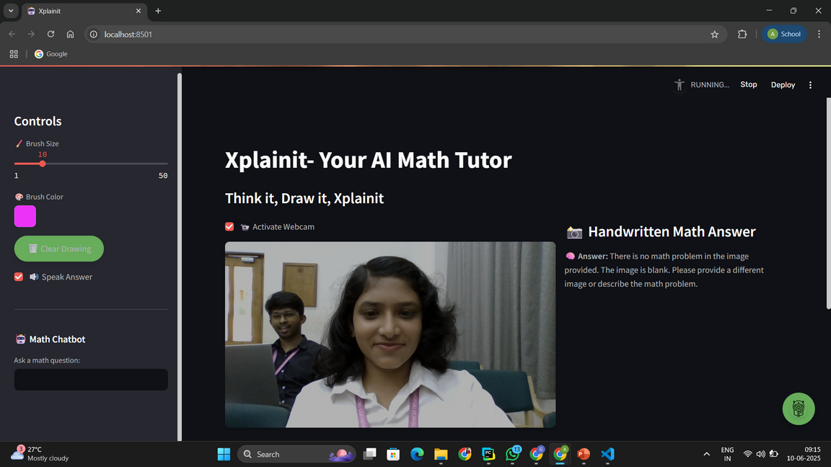
Infyra
XplainIt
DEMO
Let’s see the demo of our project!

Slide 8
Infyra
HOW IT WORKS
Technical Overview
1. App Interface Initialization
Built using Streamlit – a Python-based UI framework
Interface layout includes:
- Webcam Feed + Drawing Canvas
- Sidebar: Brush size, color picker, clear button
- Answer Area: Shows AI response
- Speech Toggle: Enable/disable text-to-speech
🔧 Key Streamlit Elements:
st.sidebar.slider() – Brush size
st.checkbox() – Run toggle, TTS option
st.image() / st.columns() – Layout controls
2. Webcam Setup & Hand Detection
Webcam initialized using cv2.VideoCapture
Hand tracking via cvzone.HandTrackingModule (uses MediaPipe)
Gesture Logic:
- MediaPipe detects 21 hand landmarks
- fingersUp() checks finger positions:
> Index & Middle fingers up → Start Drawing
> All fingers up → Trigger AI solver

Slide 9
Infyra
HOW IT WORKS
Technical Overview
5. Output Display
Gemini returns a step-by-step explanation
Answer shown using:
st.markdown()
6. Text-to-Speech (TTS)
If enabled, response spoken aloud using:
engine.say(output_text)
engine.runAndWait()
Makes app accessible for visually impaired & auditory learners
3. Drawing on Canvas
Blank canvas (NumPy array) overlays webcam feed
Drawing detected by tracking fingertip positions
Lines drawn using:
cv2.line(canvas, curr_pos, prev_pos, color, thickness)
4. Gesture-Based AI Trigger
On gesture: 4 fingers up
Canvas converted to image:
PIL.Image.fromarray(canvas)
Sent to Gemini LLM with prompt:
"Solve this math problem" (Uses Google.generativeai)

Slide 10

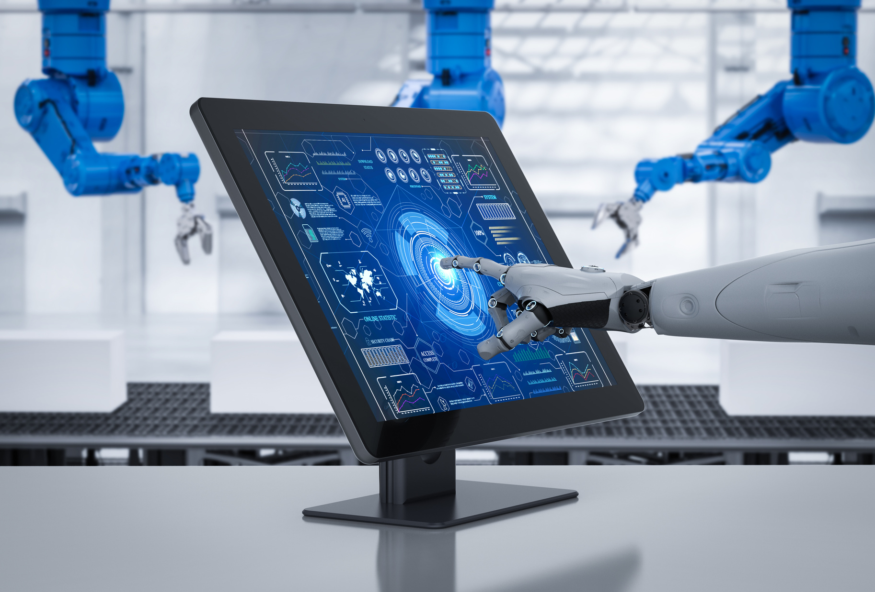
Infyra
Tools & Tech behind
XplainIt
Python – Core development language
NumPy – Canvas creation and array manipulation
PIL (Pillow) – Convert canvas to image format for AI
OpenCV – Live webcam feed, image capture
cvzone + MediaPipe – Hand gesture detection using 21-point landmark tracking
Streamlit – Web-based UI framework with interactive widgets (sliders, checkboxes, buttons)
Google Generative AI (Gemini) – LLM that interprets and solves hand-drawn math problems
pyttsx3 – Text-to-speech conversion for reading AI-generated answers aloud
threading - The app doesn’t freeze and it makes the TTS and chatbot work asynchronously

Slide 11

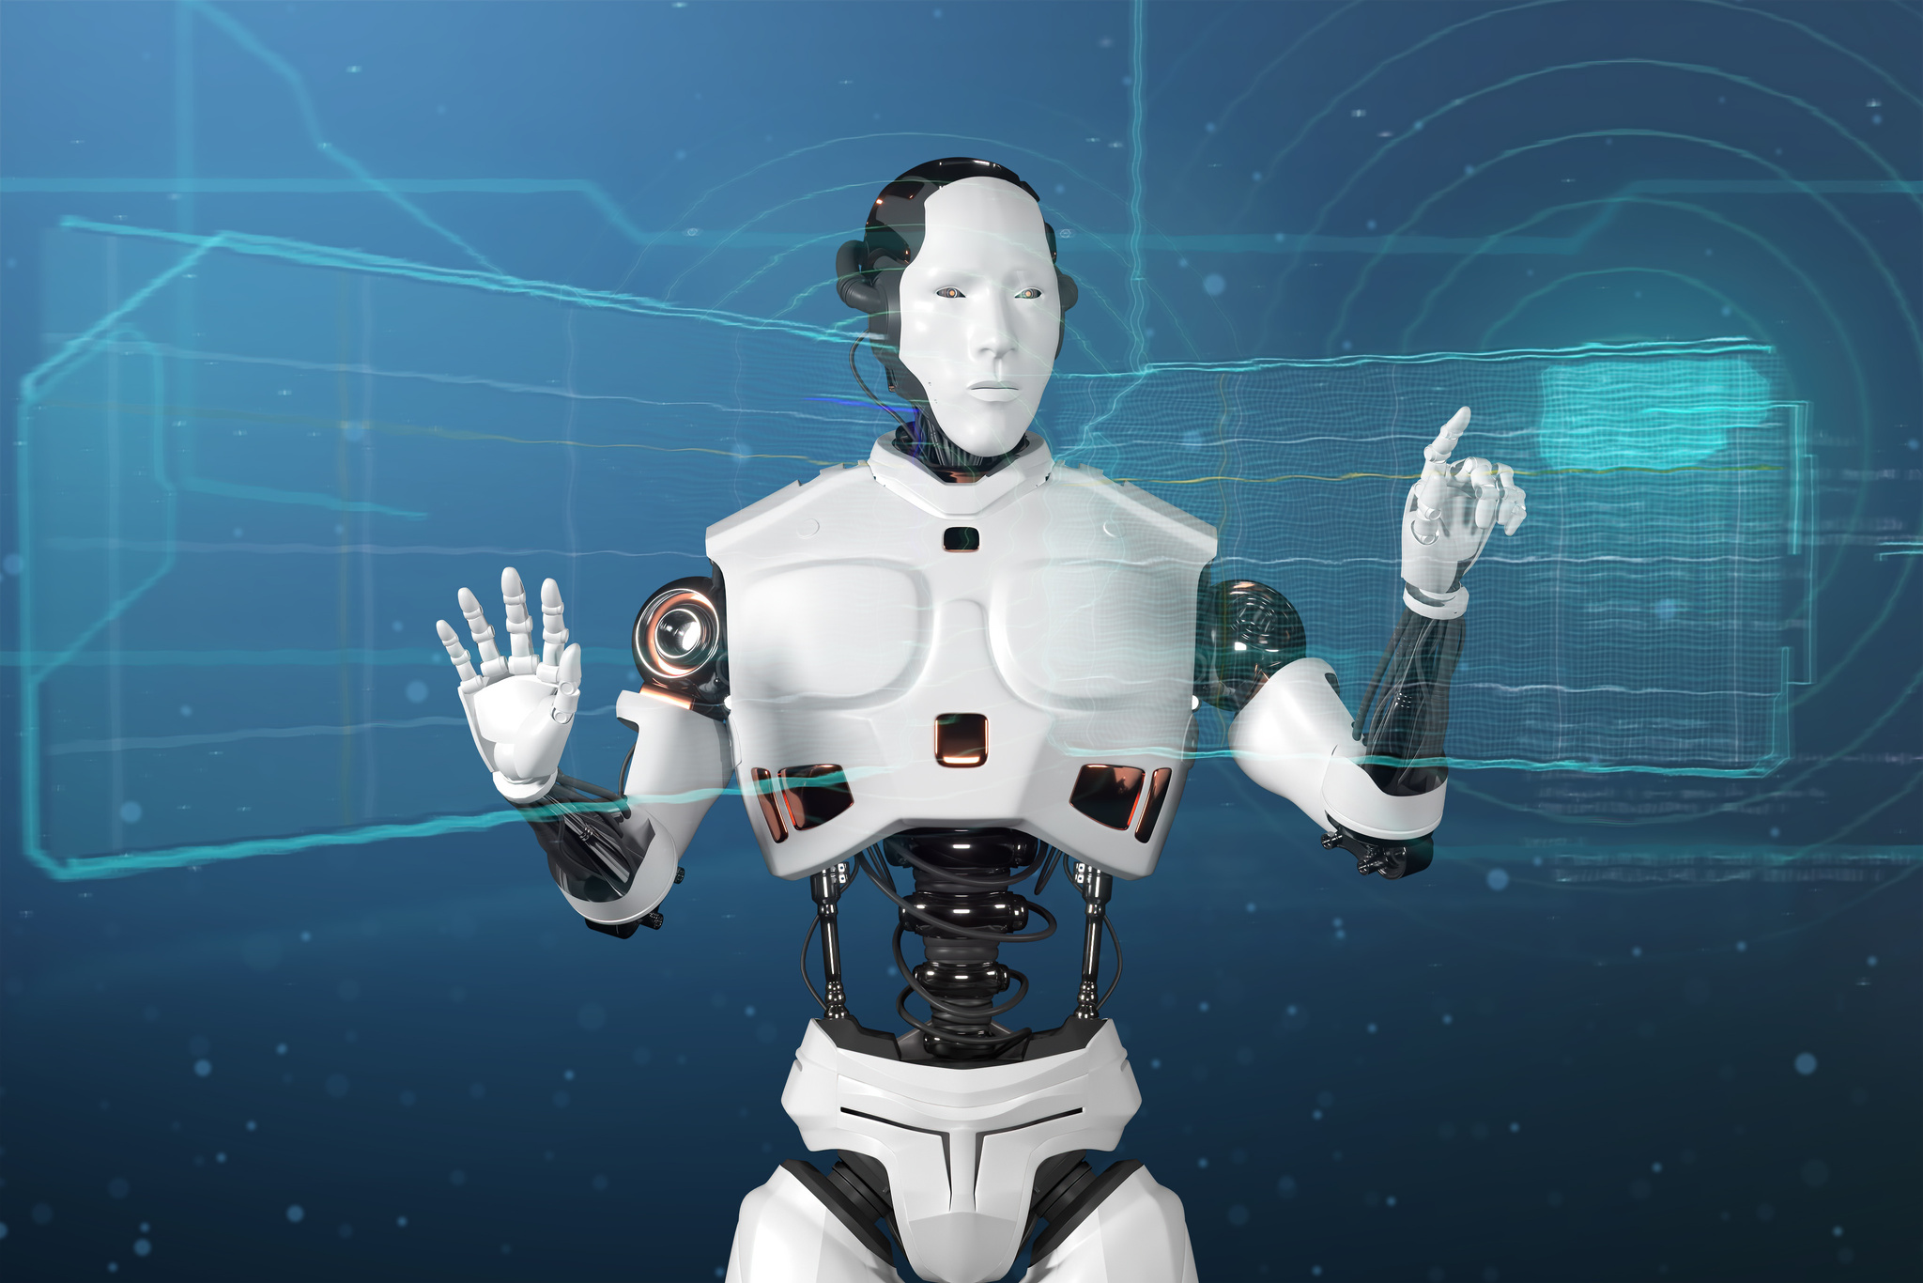
Infyra
Audio Output for Accessibility
Converts AI explanations into speech
Helps: Visually impaired users, Auditory learners, Young or slow learners
Boosts engagement & inclusivity
Built-in AI Chatbot
Ask follow-up questions like:
1. “Why is √25 = 5?”
2. “Explain the quadratic formula”
Makes learning interactive and conversational

Slide 12

Infyra
Interactive UI
Built with Streamlit – features:
Webcam preview
Canvas for gesture drawing
AI Output Text Box
Audio Button (TTS)
Chatbot Section
Future Scope
Support for advanced math (integrals, graphs, etc.)
Mobile app with gesture input
Multilingual voice explanations
Smart tutoring mode (adaptive to student level)

Slide 13

Infyra
Thank You
GitHub : https://github.com/annceeliju/AI_Math_Tutor
ANY QUESTIONS?
Presented By
Team Infyra

